Slide 1

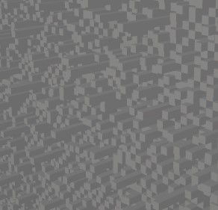
Project Presentation - ShadowPix
Implementation based on the paper: shadowpix
Presentation by: Doron Kopit, Yariv levy Algorithms for Modeling, Fabrication and Printing of 3D Objects, winter 2020/21

Slide 2
Intro
In our project we implemented the paper : “SHADOWPIX: Multiple Images from Self Shadowing” by Amit Bermano, Ilya Baran, Marc Alexa, Wojciech Matusik
ShadowPix are printable objects that display multiple images by self-shadowing the object when lit from multiple directions
The paper speaks about 2 methods
Local Method:
Consists of 3 pictures(directions of lighting)
Solved by solving a system of equations and constraints
Additional algorithm to reduce the height of the printed object- chamfering
Global Method:
Consists of d pictures as number of directions of lighting (mainly 4)
Algorithm: randomly change object to minimize cost function

Slide 3
Our project
Implementation of Local method - including chamfering
Implementation of Global method
Expanding the optimization problem to different methods of solving:
Biasing the randomness
Changing initial point of start
Implementation of a visualizer
threejs web implementation (low quality)
Autodesk Maya (high quality)
Implementation of a “PixModel” – an attempt to learn and improve from step to step

Slide 4
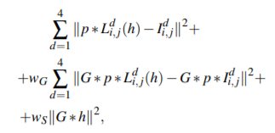
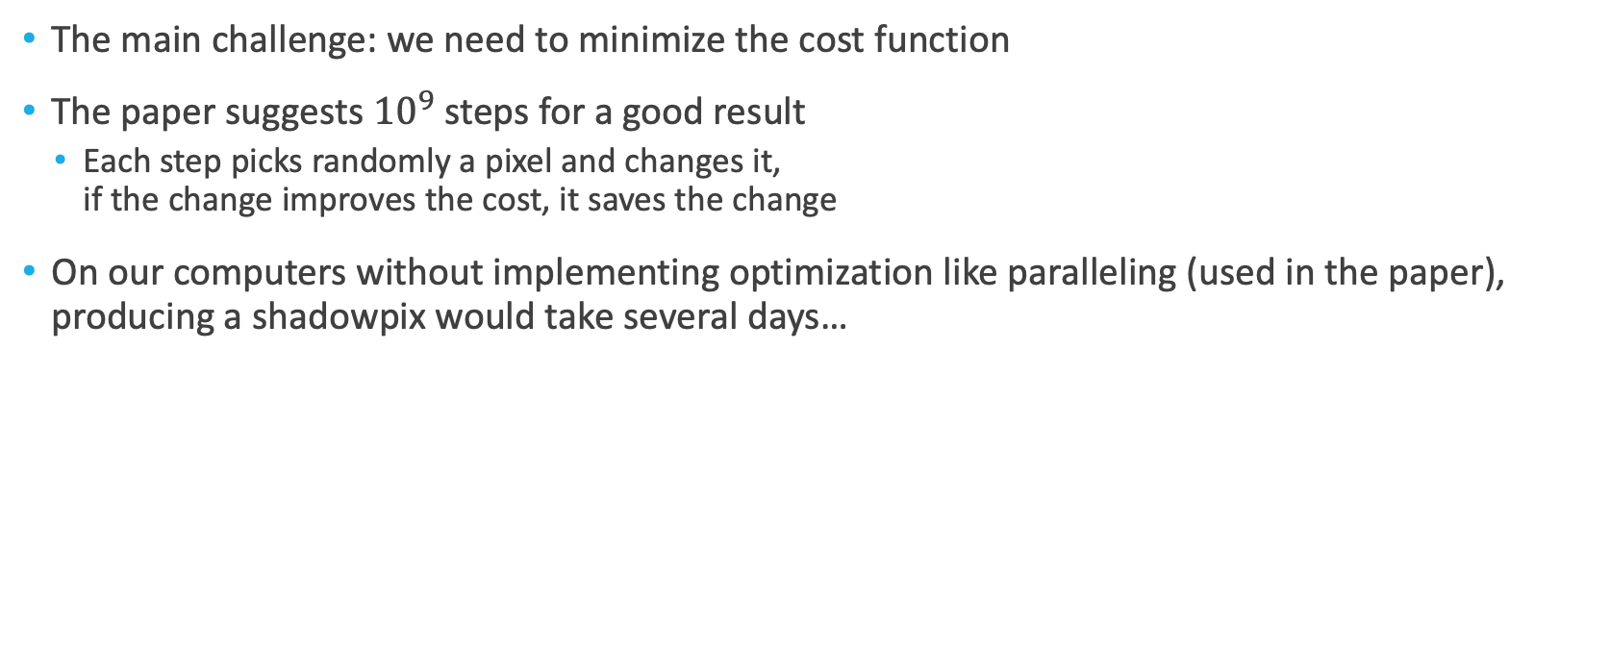
Approach to global method
The main challenge: we need to minimize the cost function
The paper suggests ${10}^{9}$ steps for a good result
Each step picks randomly a pixel and changes it, if the change improves the cost, it saves the change
On our computers without implementing optimization like paralleling (used in the paper), producing a shadowpix would take several days…

Slide 5
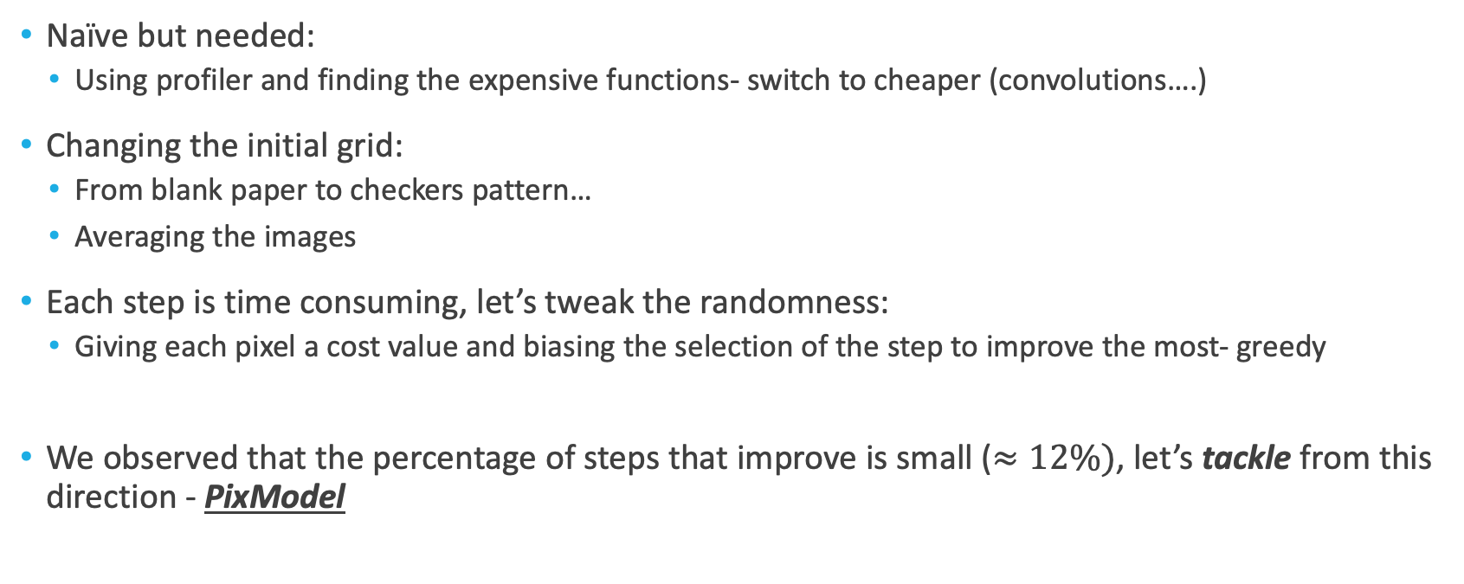
Optimization methods/stages
Naïve but needed:
Using profiler and finding the expensive functions- switch to cheaper (convolutions….)
Changing the initial grid:
From blank paper to checkers pattern…
Averaging the images
Each step is time consuming, let’s tweak the randomness:
Giving each pixel a cost value and biasing the selection of the step to improve the most- greedy
We observed that the percentage of steps that improve is small ($≈12\%)$, let’s tackle from this direction - PixModel

Slide 6
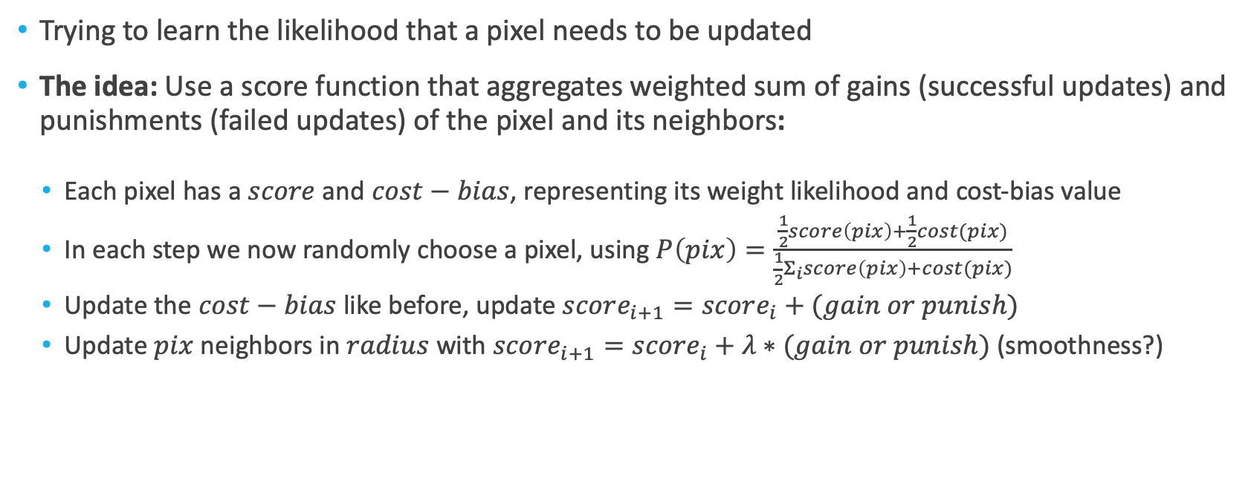
PixModel
Trying to learn the likelihood that a pixel needs to be updated
The idea: Use a score function that aggregates weighted sum of gains (successful updates) and punishments (failed updates) of the pixel and its neighbors:
Each pixel has a $score$ and $cost−bias$, representing its weight likelihood and cost-bias value
In each step we now randomly choose a pixel, using $P\left(pix\right)=\frac{\frac{1}{2}score\left(pix\right)+\frac{1}{2}cost(pix)}{\frac{1}{2}Σ_{i}score\left(pix\right)+cost(pix)}$
Update the $cost−bias$ like before, update $score_{i+1}=score_{i}+(gain or punish)$
Update $pix$ neighbors in $radius$ with $score_{i+1}=score_{i}+λ∗(gain or punish)$ (smoothness?)

Slide 7
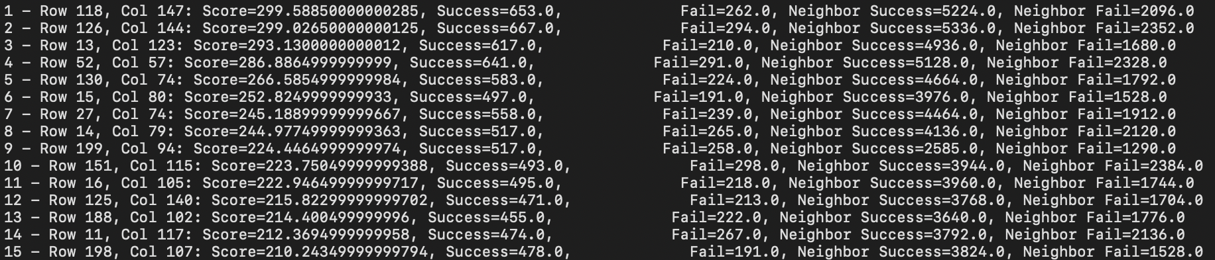
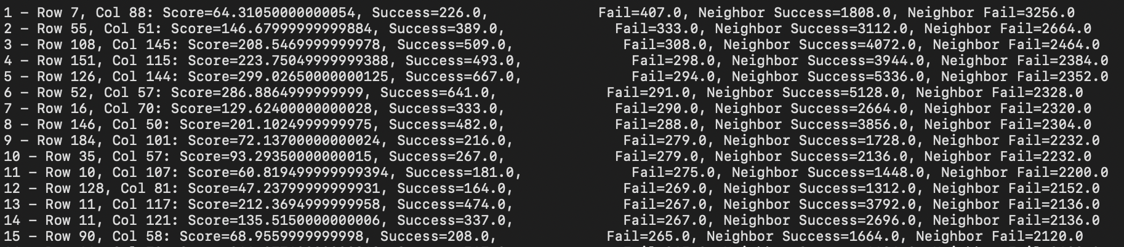
PixModel - stats
Top scoring pixels ->
Most failed updates pixels ->

Slide 8
Other challenges
Creating heavy (memory size) but simple meshes efficiently
Started with trimesh until identifying it as a bottleneck
Writing .OBJ file independently
Difficult to debug - hard to see visual results
Prioritizing a visualizer in an early stage
Rendering shadows isn’t easy
Using an algorithm which requires long runtimes
Running on multiple platforms simultaneously

Slide 9

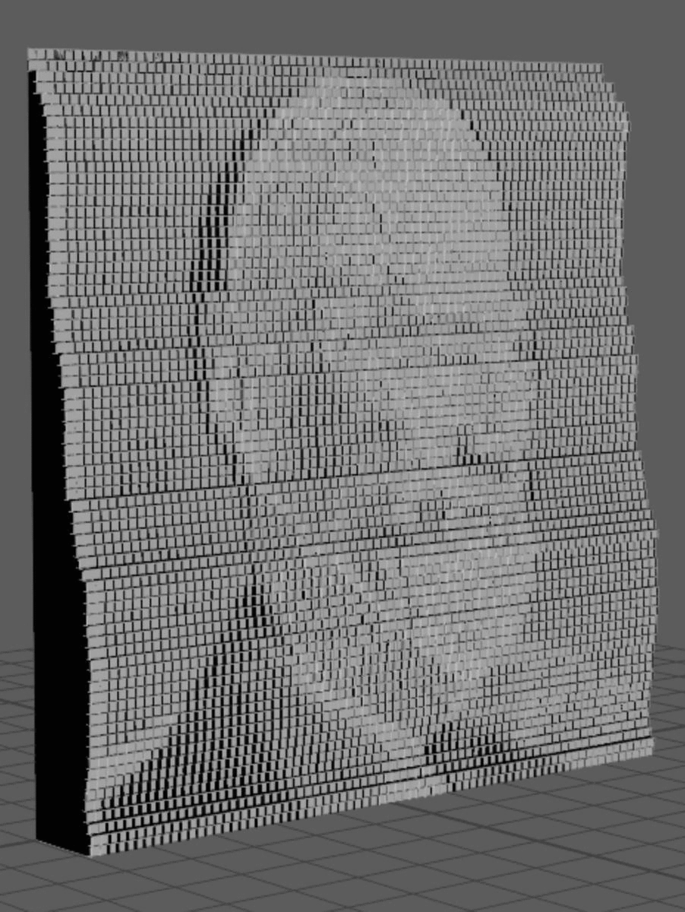
Samples – Local method, chamfers

Slide 10
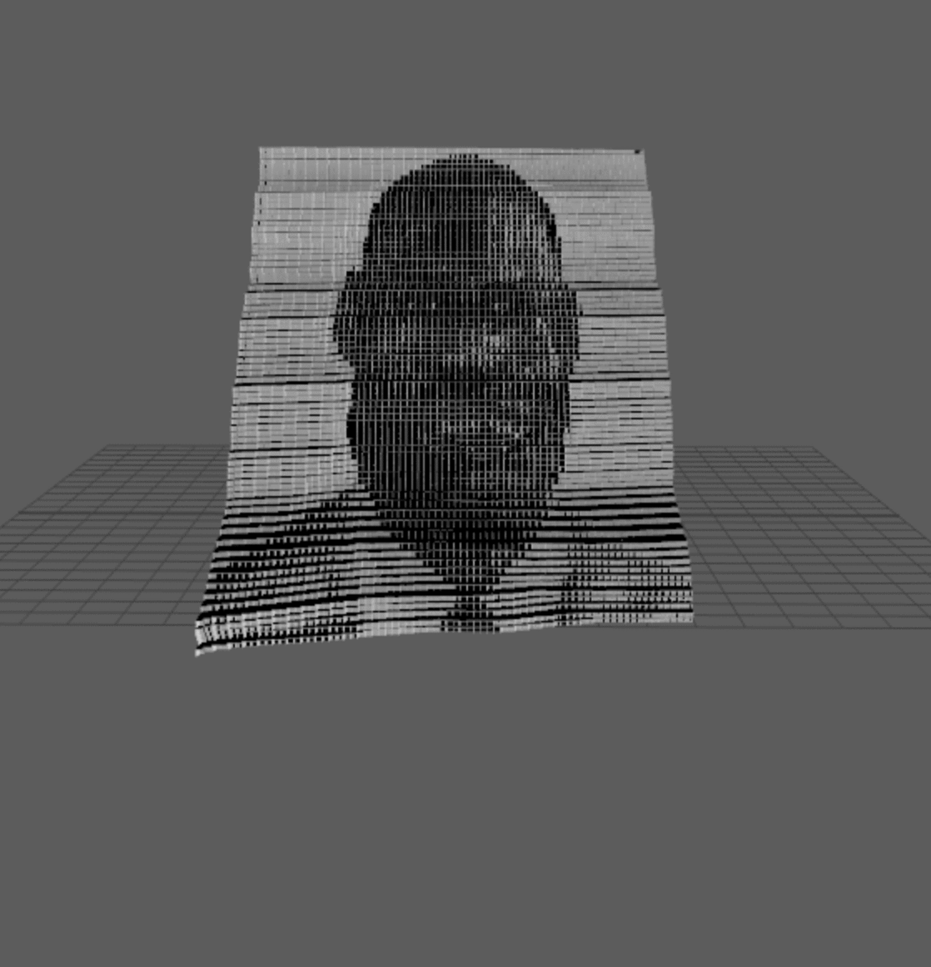
Local method, no chamfers

Slide 11
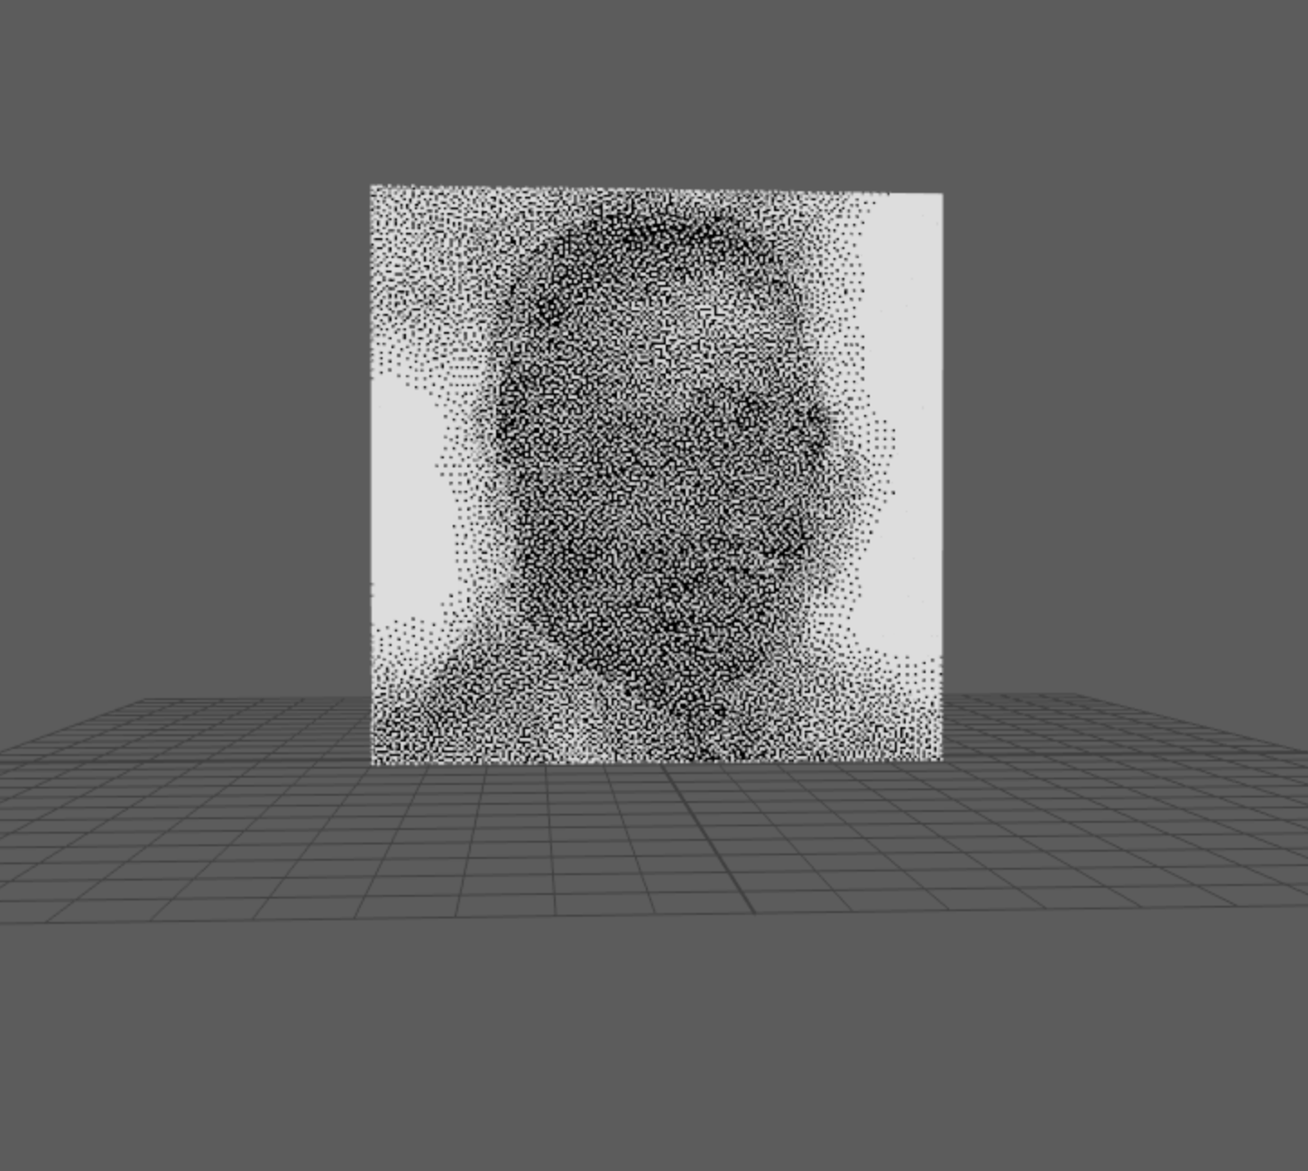
Global method, bias

Slide 12
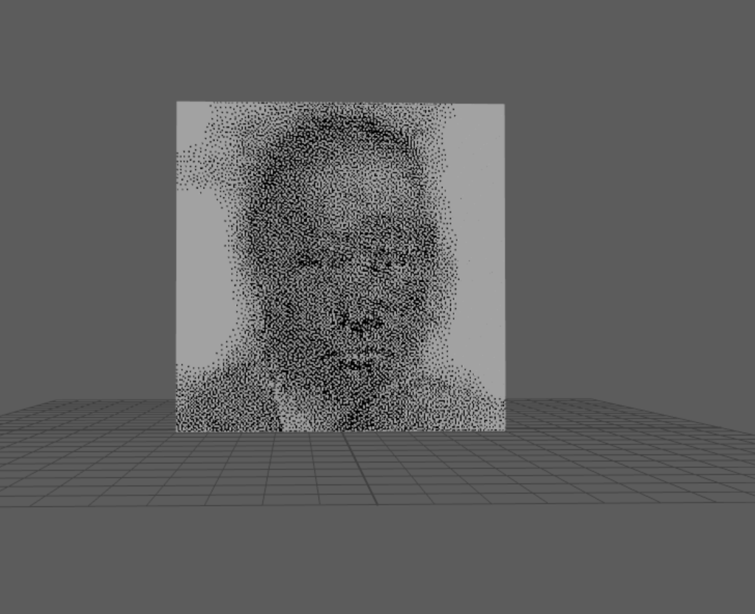
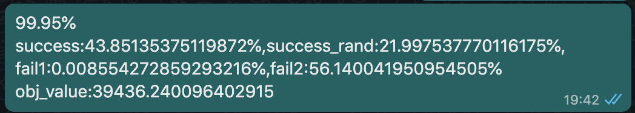
Global method, PixModel (+bias)
More accuracy, slower convergence (comparing to bias)
Improved ~12% to ~22%!

Slide 13
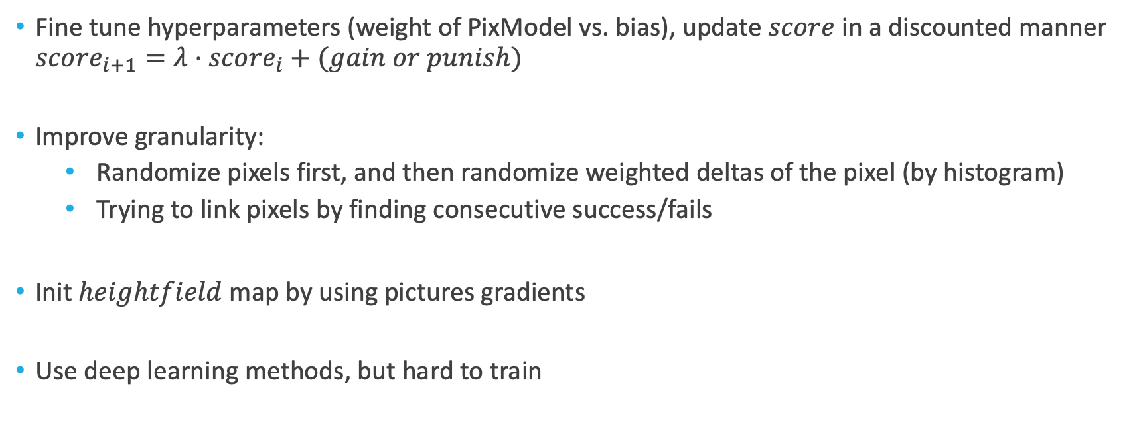
How could we improve?
Fine tune hyperparameters (weight of PixModel vs. bias), update $score$ in a discounted manner $score_{i+1}=λ⋅score_{i}+(gain or punish)$
Improve granularity:
Randomize pixels first, and then randomize weighted deltas of the pixel (by histogram)
Trying to link pixels by finding consecutive success/fails
Init $heightfield$ map by using pictures gradients
Use deep learning methods, but hard to train

Slide 14
